Slide 1

CSE3251
Computer Networks
Dr. Asif Zaman
Professor, CSE, RU

Slide 2
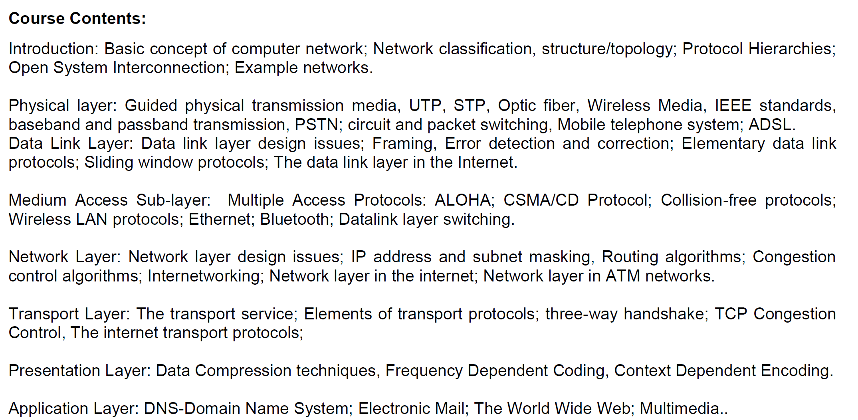

Slide 3
HDLC
HDLC: High-level Data Link Control (HDLC)
High-level Data Link Control (HDLC) is a group of communication protocols of the data link layer for transmitting data between network points or nodes.
Normal Response Mode (NRM)
Asynchronous Balanced Mode (ABM)

Slide 4
HDLC-Transfer Modes
Normal Response Mode (NRM) − two types of stations are there,
a primary station that send commands and
secondary station that can respond to received commands.
It is used for both point - to - point and multipoint communications.

Slide 5
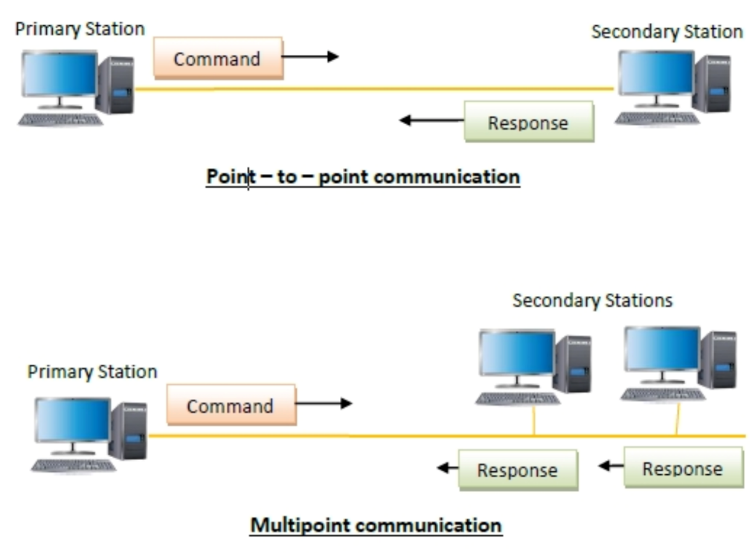
HDLC-Transfer Modes-NRM

Slide 6
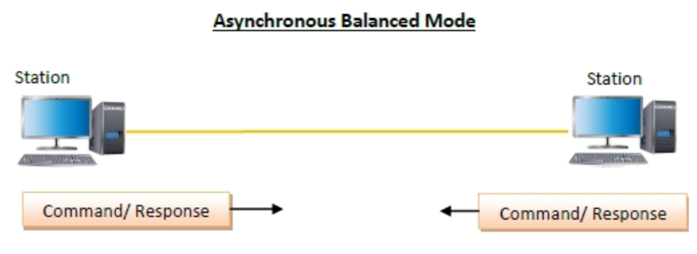
HDLC-Transfer Modes-ABM
Asynchronous Balanced Mode (ABM)
the configuration is balanced, i.e. each station can both send commands and respond to commands. It is used for only point - to - point communications.

Slide 7
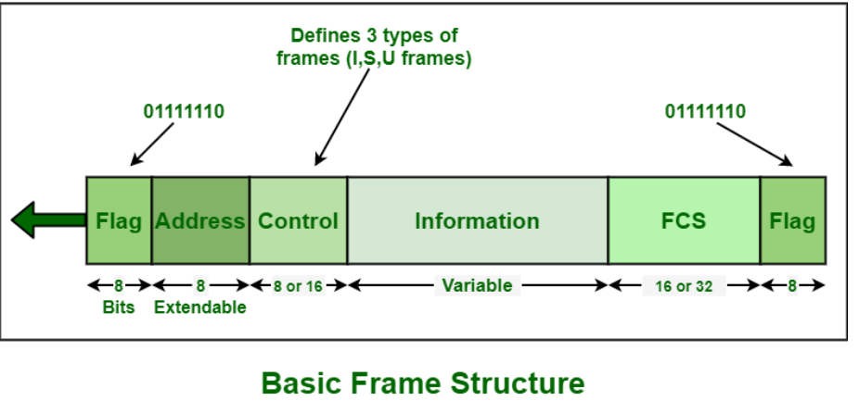
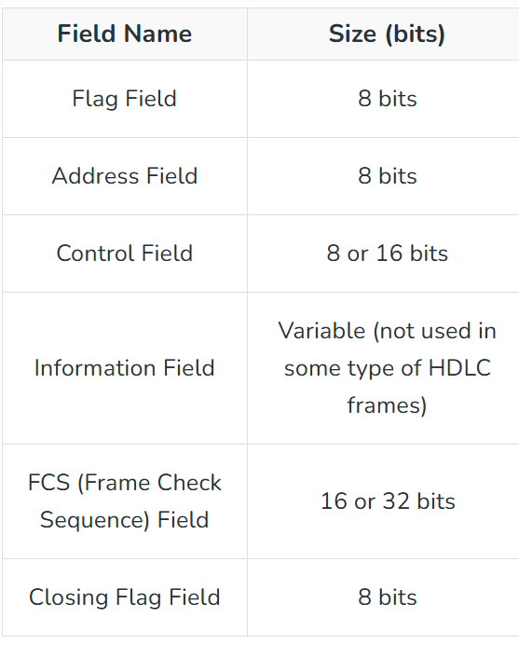
Basic Frame Structure
Flag Field –
It is an 8-bit sequence with a bit pattern 01111110 that basically helps in identifying both starting and end of a frame
This bit pattern also serves as a synchronization pattern for receiver. This bit pattern is also not allowed to occur anywhere else inside a complete frame.

Slide 8
Basic Frame Structure
Address Field –
This field can be of 1 byte or several bytes long
Receiver address

Slide 9
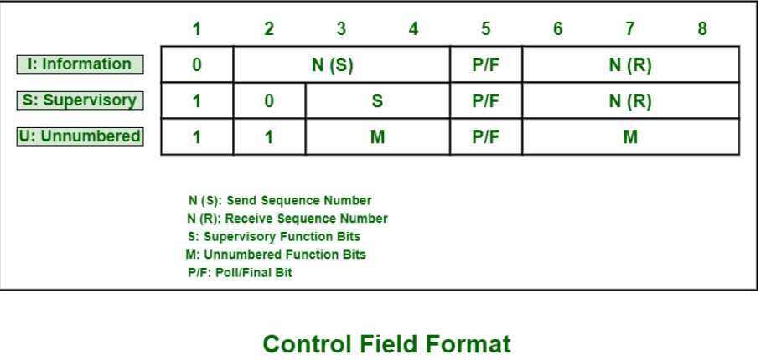
Basic Frame Structure
https://www.geeksforgeeks.org/basic-frame-structure-of-hdlc/

Slide 10
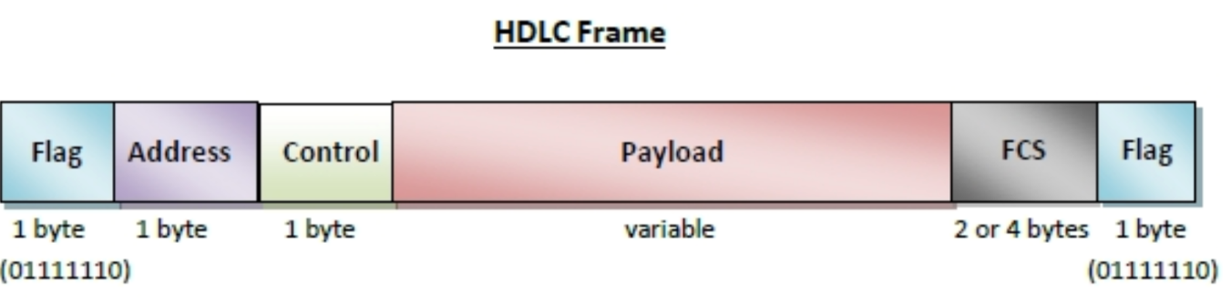

Slide 11
Types of HDLC Frames
There are three types of HDLC frames.
I- frame
S- frame
U- frame

Slide 12
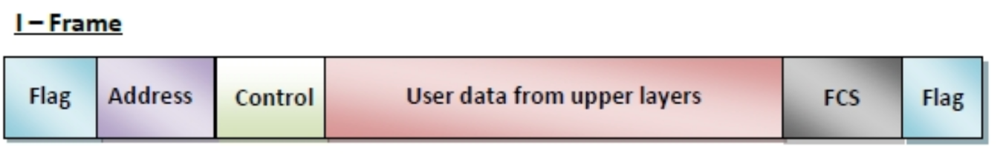
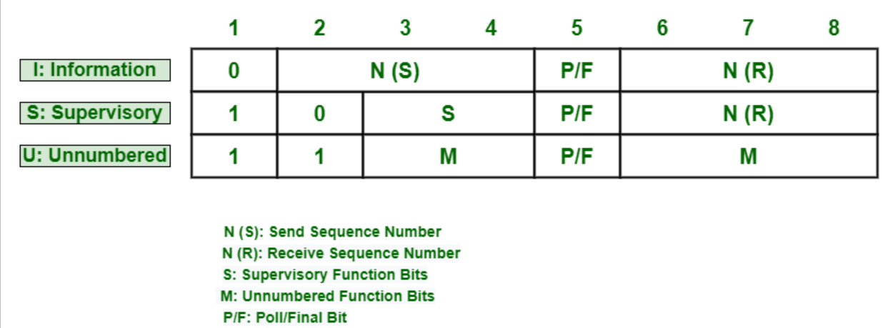
I-frame −
I-frames or Information frames carry user data from the network layer.
They also include flow and error control information that is piggybacked on user data.
The first bit of control field of I-frame is 0.

Slide 13
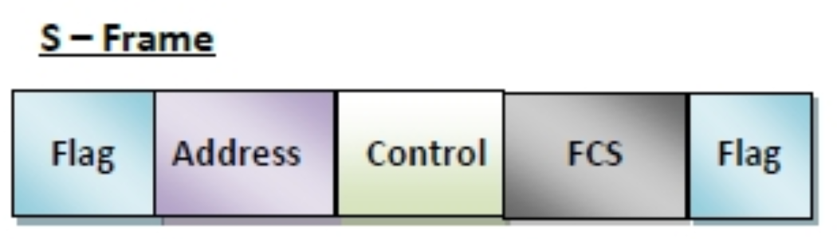
S-frame −
S-frames or Supervisory frames do not contain information field.
They are used for flow and error control ….
The first two bits of control field of S-frame is 10.

Slide 14
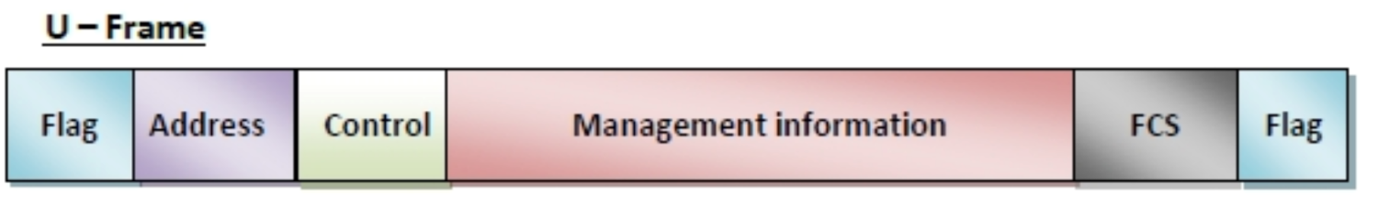
U-frame −
U-frames or Un-numbered frames are used for myriad miscellaneous functions, like link management.
It may contain an information field, if required.
The first two bits of control field of U-frame is 11.
https://www.tutorialspoint.com/high-level-data-link-control-hdlc

